Slide 1

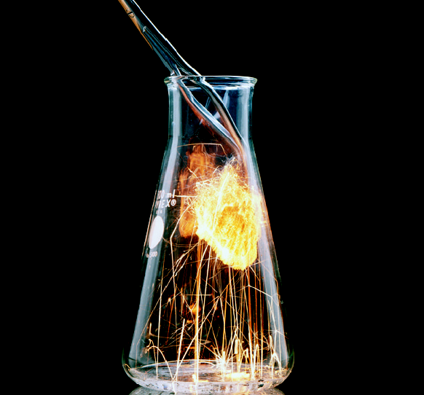

CHAPTER 6
Chemical Periodicity

Slide 2
Chapter Goals
More About the Periodic Table
Periodic Properties of the Elements
Atomic Radii
Ionization Energy
Electron Affinity
Ionic Radii
Electronegativity

Slide 3
Chapter Goals
Chemical Reactions and Periodicity
Hydrogen & the Hydrides
  Hydrogen
  Reactions of Hydrogen and the Hydrides
Oxygen & the Oxides
  Oxygen and Ozone
  Reactions of Oxygen and the Oxides
  Combustion Reactions
  Combustion of Fossil Fuels and Air Pollution

Slide 4
More About the Periodic Table
Establish a classification scheme of the elements based on their electron configurations.
Noble Gases
  All of them have completely filled electron shells.
Since they have similar electronic structures, their chemical reactions are similar.
  He 1s²
  Ne [He] 2s² 2p⁶
  Ar [Ne] 3s² 3p⁶
  Kr [Ar] 4s² 4p⁶
  Xe [Kr] 5s² 5p⁶
  Rn [Xe] 6s² 6p⁶

Slide 5
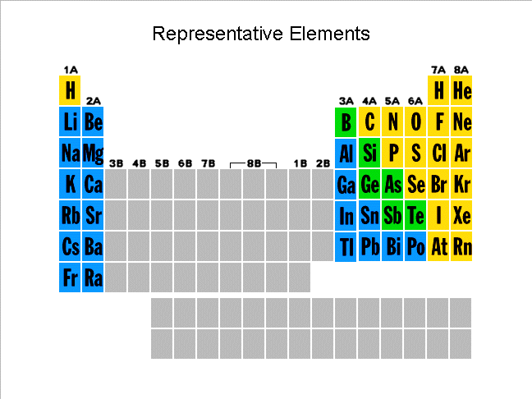
More About the Periodic Table
Representative Elements
  Are the elements in A groups on periodic chart.
These elements will have their “last” electron in an outer s or p orbital.
These elements have fairly regular variations in their properties.

Slide 6
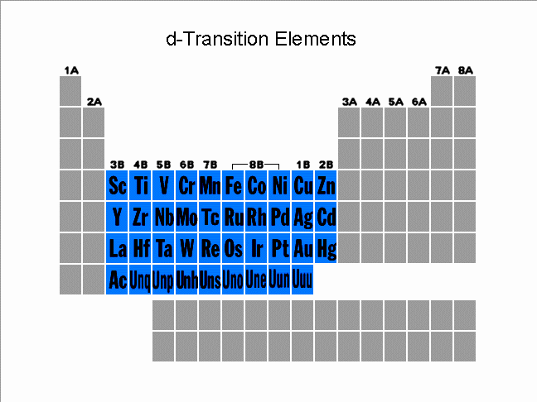
More About the Periodic Table
d-Transition Elements
  Elements on periodic chart in B groups.
  Sometimes called transition metals.
Each metal has d electrons.
  ns (n-1)d configurations
These elements make the transition from metals to nonmetals.
Exhibit smaller variations from row-to-row than the representative elements.

Slide 7
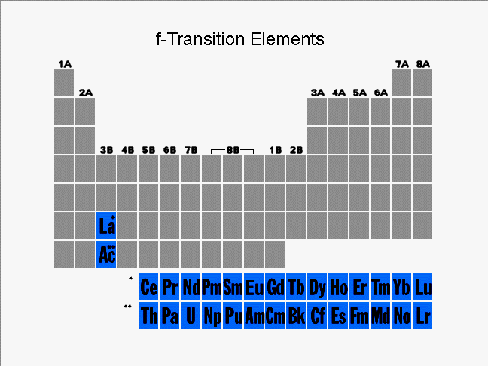
More About the Periodic Table
f - transition metals
  Sometimes called inner transition metals.
Electrons are being added to f orbitals.
Electrons are being added two shells below the valence shell!
Consequently, very slight variations of properties from one element to another.
Outermost electrons have the greatest influence on the chemical properties of elements.

Slide 8
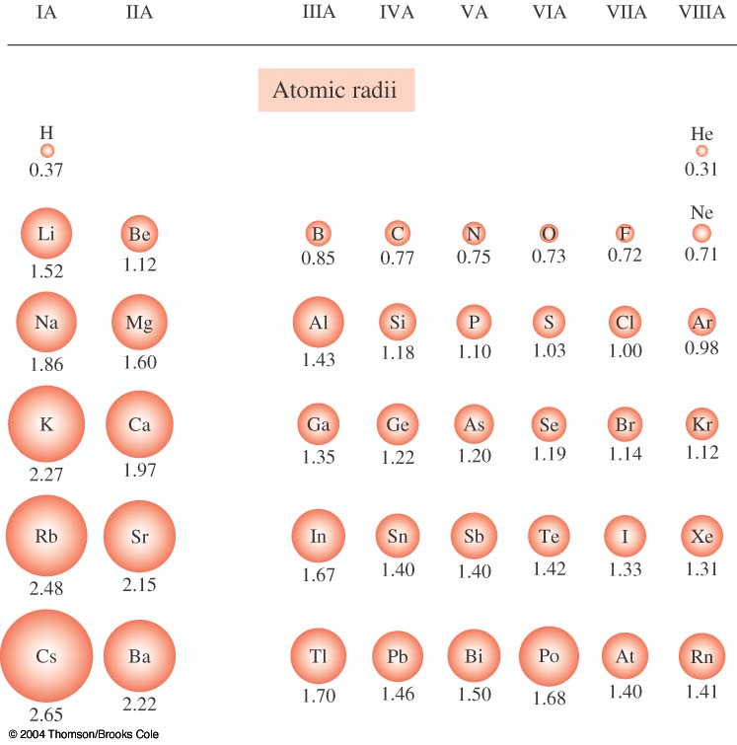
Periodic Properties of the Elements
Atomic Radii
Atomic radii describes the relative sizes of atoms.
Atomic radii increase within a column going from the top to the bottom of the periodic table.
Atomic radii decrease within a row going from left to right on the periodic table.
  This last fact seems contrary to intuition.
  How does nature make the elements smaller even though the electron number is increasing?

Slide 9
Atomic Radii
The reason the atomic radii decrease across a period is due to shielding or screening effect.
  Effective nuclear charge, Z_{eff}, experienced by an electron is less than the actual nuclear charge, Z.
  The inner electrons block the nuclear charge’s effect on the outer electrons.
Moving across a period, each element has an increased nuclear charge and the electrons are going into the same shell (2s and 2p or 3s and 3p, etc.).
  Consequently, the outer electrons feel a stronger effective nuclear charge.
  For Li, Z_{eff} ~ +1
  For Be, Z_{eff} ~ +2

Slide 10

Atomic Radii
Example 6-1: Arrange these elements based on their atomic radii.
  Se, S, O, Te
You do it!
O < S < Se < Te

Slide 11
Atomic Radii
Example 6-2: Arrange these elements based on their atomic radii.
  P, Cl, S, Si
You do it!
Cl < S < P < Si

Slide 12
Atomic Radii
Example 6-3: Arrange these elements based on their atomic radii.
  Ga, F, S, As
You do it!
F < S < As < Ga

Slide 13


Ionization Energy
First ionization energy (IE₁)
  The minimum amount of energy required to remove the most loosely bound electron from an isolated gaseous atom to form a 1+ ion.
Symbolically:
  Atom_{(g)} + energy → ion⁺_{(g)} + e⁻
Mg_{(g)} + 738kJ/mol → Mg⁺ + e⁻

Slide 14

Ionization Energy
Second ionization energy (IE₂)
  The amount of energy required to remove the second electron from a gaseous 1+ ion.
Symbolically:
  ion⁺ + energy → ion²⁺ + e⁻
Mg⁺ + 1451 kJ/mol →Mg²⁺ + e⁻
Atoms can have 3rd (IE₃), 4th (IE₄), etc. ionization energies.

Slide 15
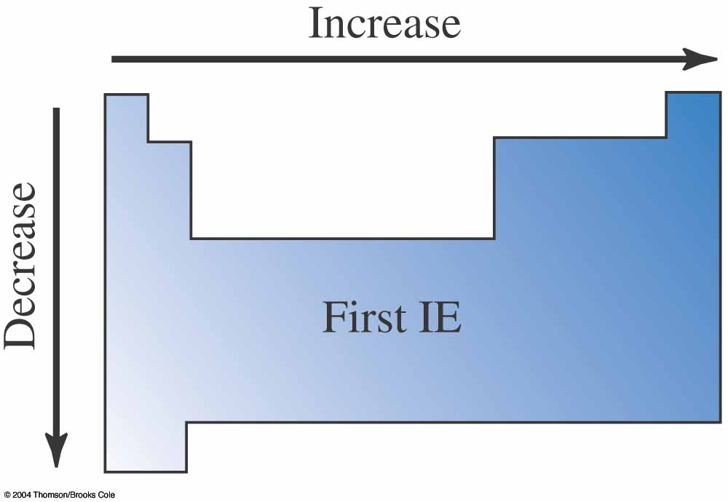
Ionization Energy
Periodic trends for Ionization Energy:
  IE₂ > IE₁
    It always takes more energy to remove a second electron from an ion than from a neutral atom.
  IE₁ generally increases moving from IA elements to VIIIA elements.
    Important exceptions at Be & Mg, N & P, etc. due to filled and half-filled subshells.
  IE₁ generally decreases moving down a family.
    IE₁ for Li > IE₁ for Na, etc.

Slide 16
First Ionization Energies of Some Elements
He
Ne
F
Ar
N
Cl
C
P
H
Be
O
Mg
S
Ca
B
Si
Li
Na
Al
K

Slide 17
Ionization Energy
Example 6-4: Arrange these elements based on their first ionization energies.
  Sr, Be, Ca, Mg
You do it!
Sr < Ca < Mg < Be

Slide 18
Ionization Energy
Example 6-5: Arrange these elements based on their first ionization energies.
  Al, Cl, Na, P
You do it!
Na < Al < P < Cl

Slide 19
Ionization Energy
Example 6-6: Arrange these elements based on their first ionization energies.
  B, O, Be, N
You do it!
B < Be < O < N

Slide 20
Ionization Energy
First, second, third, etc. ionization energies exhibit periodicity as well.
Look at the following table of ionization energies versus third row elements.
  Notice that the energy increases enormously when an electron is removed from a completed electron shell.

Slide 21
Ionization Energy
Group and element | IA Na | IIA Mg | IIIA Al | IVA Si
IE₁ (kJ/mol) | 496 | 738 | 578 | 786
IE₂ (kJ/mol) | 4562 | 1451 | 1817 | 1577
IE₃ (kJ/mol) | 6912 | 7733 | 2745 | 3232
IE₄ (kJ/mol) | 9540 | 10,550 | 11,580 | 4356

Slide 22
Ionization Energy
The reason Na forms Na⁺ and not Na²⁺ is that the energy difference between IE₁ and IE₂ is so large.
  Requires more than 9 times more energy to remove the second electron than the first one.
The same trend is persistent throughout the series.
  Thus Mg forms Mg²⁺ and not Mg³⁺.
  Al forms Al³⁺.

Slide 23
Ionization Energy
Example 6-7: What charge ion would be expected for an element that has these ionization energies?
You do it!
IE₁ (kJ/mol) | 1680
IE₂ (kJ/mol) | 3370
IE₃ (kJ/mol) | 6050
IE₄ (kJ/mol) | 8410
IE₅ (kJ/mol) | 11020
IE₆ (kJ/mol) | 15160
IE₇ (kJ/mol) | 17870
IE₈ (kJ/mol) | 92040
Notice that the largest increase in ionization energies occurs
between IE₇ and IE₈. Thus this element would form a 1- ion.

Slide 24


Electron Affinity
Electron affinity is the amount of energy absorbed when an electron is added to an isolated gaseous atom to form an ion with a 1- charge.
Sign conventions for electron affinity.
  If electron affinity > 0 energy is absorbed.
  If electron affinity < 0 energy is released.
Electron affinity is a measure of an atom’s ability to form negative ions.
Symbolically:
atom(g) + e⁻ + EA → ion⁻(g)

Slide 25
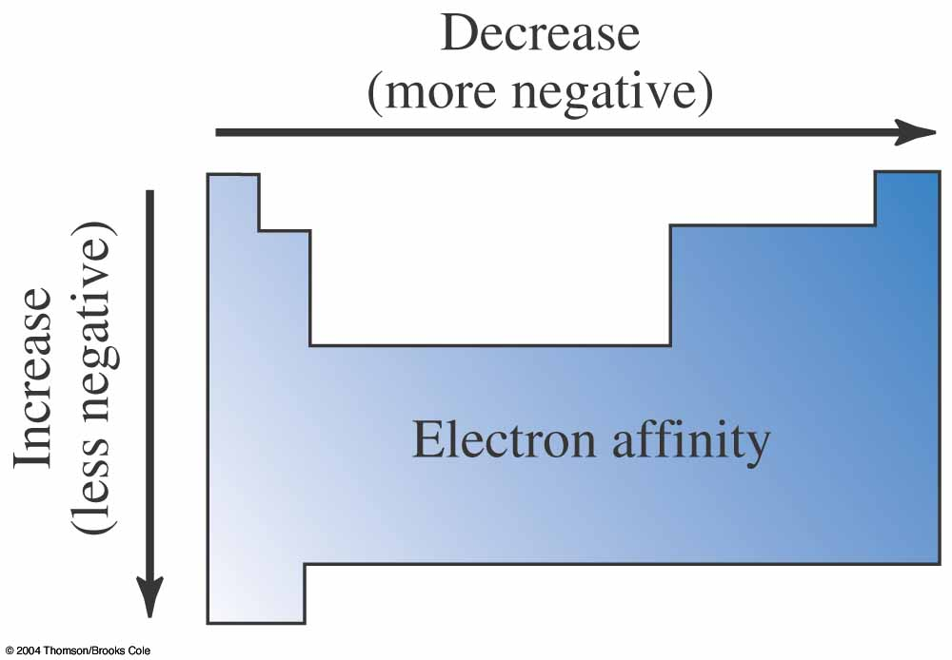
Electron Affinity
Two examples of electron affinity values:
Mg_{(g)} + e⁻ + 231 kJ/mol → Mg⁻_{(g)}
EA = +231 kJ/mol
Br_{(g)} + e⁻ → Br⁻_{(g)} + 323 kJ/mol
  EA = -323 kJ/mol

Slide 26
Electron Affinity
General periodic trend for electron affinity is
  the values become more negative from left to right across a period on the periodic chart.
  the values become more negative from bottom to top up a row on the periodic chart.
Measuring electron affinity values is a difficult experiment.

Slide 27
Electron Affinity
He
Be
B
N
Ne
Mg
Al
Ar
Ca
Na
P
K
H
Li
O
C
Si
S
F
Cl

Slide 28
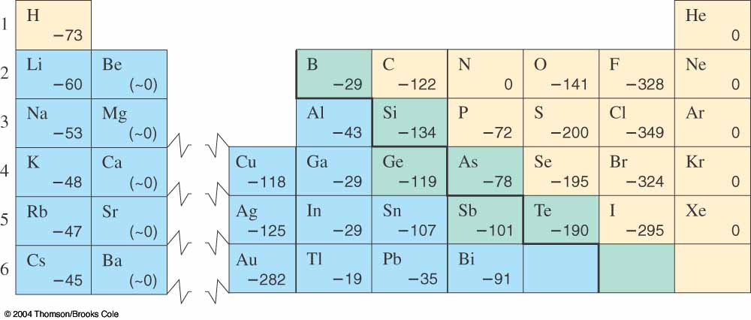
Electron Affinity

Slide 29
Electron Affinity
Example 6-8: Arrange these elements based on their electron affinities.
  Al, Mg, Si, Na
You do it!
Si < Al < Na < Mg

Slide 30
Ionic Radii
Cations (positive ions) are always smaller than their respective neutral atoms.
Element | Na | Mg | Al
Atomic Radius (Å) | 1.86 | 1.60 | 1.43
Ion | Na⁺ | Mg²⁺ | Al³⁺
Ionic Radius (Å) | 1.16 | 0.85 | 0.68
Element | Li | Be
Atomic Radius (Å) | 1.52 | 1.12
Ion | Li⁺ | Be²⁺
Ionic Radius (Å) | 0.90 | 0.59

Slide 31
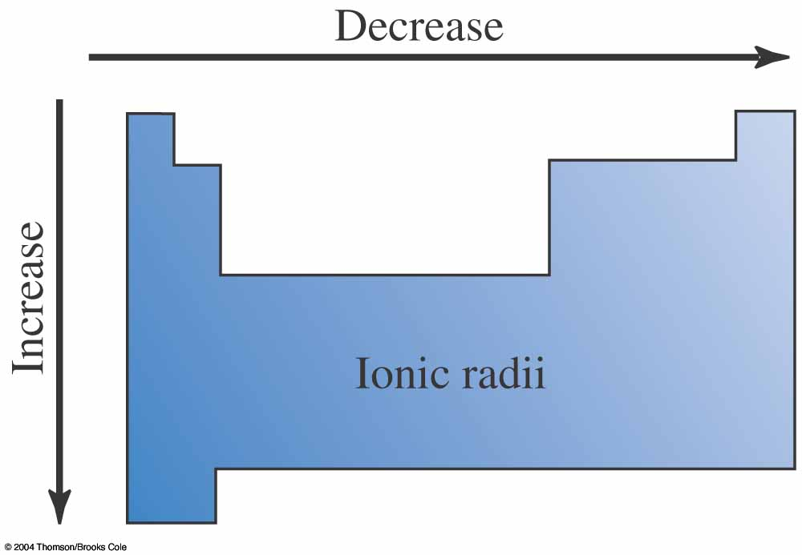
Ionic Radii
Anions (negative ions) are always larger than their neutral atoms.
Element | N | O | F
Atomic Radius(Å) | 0.75 | 0.73 | 0.72
Ion | N³⁻ | O²⁻ | F¹⁻
Ionic Radius(Å) | 1.71 | 1.26 | 1.19

Slide 32
Ionic Radii
Cation (positive ions) radii decrease from left to right across a period.
  Increasing nuclear charge attracts the electrons and decreases the radius.
Ion | Rb⁺ | Sr²⁺ | In³⁺
Ionic Radii(Å) | 1.66 | 1.32 | 0.94

Slide 33
Ionic Radii
Anion (negative ions) radii decrease from left to right across a period.
  Increasing electron numbers in highly charged ions cause the electrons to repel and increase the ionic radius.
Ion | N³⁻ | O²⁻ | F¹⁻
Ionic Radii(Å) | 1.71 | 1.26 | 1.19

Slide 34
Ionic Radii
Example 6-9: Arrange these elements based on their ionic radii.
  Ga, K, Ca
You do it!
K¹⁺ < Ca²⁺ < Ga³⁺

Slide 35
Ionic Radii
Example 6-10: Arrange these elements based on their ionic radii.
  Cl, Se, Br, S
You do it!
Cl¹⁻ < S²⁻ < Br¹⁻ < Se²⁻

Slide 36
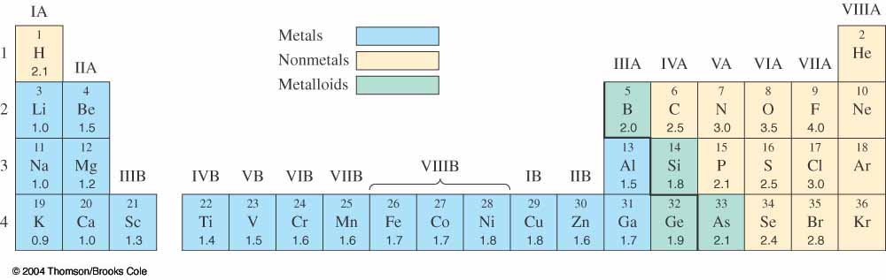
Electronegativity
Electronegativity is a measure of the relative tendency of an atom to attract electrons to itself when chemically combined with another element.
  Electronegativity is measured on the Pauling scale.
  Fluorine is the most electronegative element.
  Cesium and francium are the least electronegative elements.
For the representative elements, electronegativities usually increase from left to right across periods and decrease from top to bottom within groups.

Slide 37
Electronegativity
Example 6-11: Arrange these elements based on their electronegativity.
  Se, Ge, Br, As
You do it!
Ge < As < Se < Br

Slide 38
Electronegativity
Example 6-12: Arrange these elements based on their electronegativity.
  Be, Mg, Ca, Ba
You do it!
Ba < Ca < Mg < Be

Slide 39
Periodic Trends
It is important that you understand and know the periodic trends described in the previous sections.
  They will be used extensively in Chapter 7 to understand and predict bonding patterns.

Slide 40
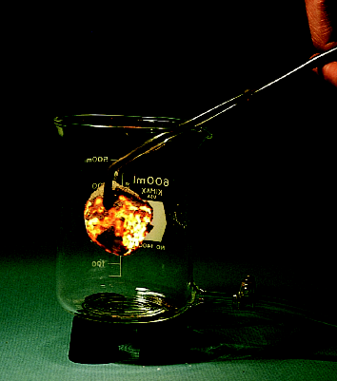
Chemical Reactions & Periodicity
In the next sections periodicity will be applied to the chemical reactions of hydrogen, oxygen, and their compounds.

Slide 41
Hydrogen and the Hydrides
Hydrogen gas, H₂, can be made in the laboratory by the reaction of a metal with a nonoxidizing acid.
Mg + 2 HCl → MgCl₂ + H₂
Hydrogen is commercially prepared by the thermal cracking of hydrocarbons.
  H₂ is commonly used in the preparation of ammonia for fertilizer production.
C₄H₁₀ → 2 C₂H₂ + 3 H₂

Slide 42
Reactions of Hydrogen and the Hydrides
Hydrogen reacts with active metals to yield hydrides.
2 K + H₂ → 2 KH
In general for IA metals, this reaction can be represented as:
2 M + H₂ → 2 MH

Slide 43
Reactions of Hydrogen and the Hydrides
The heavier and more active group IIA metals have the same reaction with hydrogen.
Ba + H₂ → BaH₂
In general this reaction for IIA metals can be represented as:
M + H₂ → MH₂

Slide 44
Reactions of Hydrogen and the Hydrides
The ionic hydrides produced in the two previous reactions are basic.
  The H⁻ reacts with water to produce H₂ and OH⁻.
H⁻ + H₂O → H₂ + OH⁻
For example, the reaction of LiH with water proceeds in this fashion.

Slide 45
Reactions of Hydrogen and the Hydrides
Hydrogen reacts with nonmetals to produce covalent binary compounds.
One example is the haloacids produced by the reaction of hydrogen with the halogens.
H₂ + X₂ → 2 HX
For example, the reactions of F₂ and Br₂ with H₂ are:
H₂ + F₂ → 2 HF
H₂ + Br₂ → 2 HBr

Slide 46
Reactions of Hydrogen and the Hydrides
Hydrogen reacts with oxygen and other VIA elements to produce several common binary covalent compounds.
  Examples of this reaction include the production of H₂O, H₂S, H₂Se, H₂Te.
2 H₂ + O₂ → 2 H₂O
8 H₂ + S₈ → 8 H₂S

Slide 47
Reactions of Hydrogen and the Hydrides
The hydrides of Group VIIA and VIA hydrides are acidic.

Slide 48
Reactions of Hydrogen and the Hydrides
There is an important periodic trend evident in the ionic or covalent character of hydrides.
Metal hydrides are ionic compounds and form basic aqueous solutions.
Nonmetal hydrides are covalent compounds and form acidic aqueous solutions.

Slide 49
Oxygen and the Oxides
Joseph Priestley discovered oxygen in 1774 using this reaction:
2 HgO_{(s)} → 2 Hg_{()} + O_{2(g)}
A common laboratory preparation method for oxygen is:
2 KClO_{3 (s)} → 2 KCl_{(s)} + 3 O_{2(g)}
Commercially, oxygen is obtained from the fractional distillation of liquid air.

Slide 50
Oxygen and the Oxides
Ozone (O₃) is an allotropic form of oxygen which has two resonance structures.
Ozone is an excellent UV light absorber in the earth’s atmosphere.
2 O_{3(g)} → 3 O_{2(g)}
in presence of UV

Slide 51
Reactions of Oxygen and the Oxides
Oxygen is an extremely reactive element.
  O₂ reacts with most metals to produce normal oxides having an oxidation number of –2.
4 Li_{(s)} + O_{2(g)} → 2 Li₂O_{(s)}
However, oxygen reacts with sodium to produce a peroxide having an oxidation number of –1.
2 Na_{(s)} + O_{2(g)} → Na₂O_{2(s)}

Slide 52
Reactions of Oxygen and the Oxides
Oxygen reacts with K, Rb, and Cs to produce superoxides having an oxidation number of -1/2.
2 Na_{(s)} + O_{2(g)} → Na₂O_{2(s)}
Oxygen reacts with IIA metals to give normal oxides.
2 M_{(s)} + O_{2(g)} → 2 MO_{(s)}
2 Sr_{(s)} + O_{2(g)} → 2 SrO_{(s)}

Slide 53
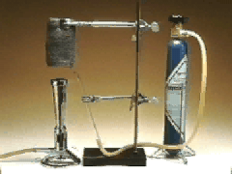
Reactions of Oxygen and the Oxides
At high oxygen pressures the IIA metals can form peroxides.
Ca_{(s)} + O_{2(g)} → CaO_{2(s)}
Metals that have variable oxidation states, such as the d-transition metals, can form variable oxides.
  For example, in limited oxygen:
2 Mn_{(s)} + O_{2(g)} → 2 MnO_{(s)}
  In excess oxygen:
4 Mn_{(s)} + 3 O_{2(g)} → 2 Mn₂O_{3(s)}

Slide 54
Reactions of Oxygen and the Oxides
Oxygen reacts with nonmetals to form covalent nonmetal oxides.
For example, the carbon reactions with oxygen:
  In limited oxygen
2 C_{(s)} + O_{2(g)} → 2 CO_{(g)}
  In excess oxygen
C_{(s)} + O_{2(g)} → CO_{2(g)}

Slide 55
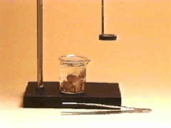
Reactions of Oxygen and the Oxides
Phosphorous reacts similarly to carbon forming two different oxides depending on the oxygen amounts:
  In limited oxygen
P_{4(s)} + 3 O_{2(g)} → P₄O_{6(s)}
  In excess oxygen
P_{4(s)} + 5 O_{2(g)} → P₄O_{10(s)}

Slide 56
Reactions of Oxygen and the Oxides
Similarly to the nonmetal hydrides, nonmetal oxides are acidic.
  Sometimes nonmetal oxides are called acidic anhydrides.
  They react with water to produce ternary acids.
    For example:
CO_{2(g)} + H₂O _{()} → H₂CO_{3(aq)}
Cl₂O_{7(s)} + H₂O _{()} → 2 HClO_{4(aq)}
As₂O_{5(s)} + 6 H₂O_{()} → 4 H₃AsO_{4(aq)}

Slide 57
Reactions of Oxygen and the Oxides
Similarly to the hydrides, metal oxides are basic.
  These are called basic anhydrides.
  They react with water to produce ionic metal hydroxides (bases)
Li₂O_{(s)} + H₂O_{()} → 2 LiOH_{(aq)}
CaO_{(s)} + H₂O _{()} → Ca(OH)_{2(aq)}
Metal oxides are usually ionic and basic.
Nonmetal oxides are usually covalent and acidic.
  An important periodic trend.

Slide 58
Reactions of Oxygen and the Oxides
Nonmetal oxides react with metal oxides to produce salts.
Li₂O_{(s)} + SO_{2(g)} → Li₂SO_{3(s)}
Cl₂O_{7(s)} + MgO_{(s)} → Mg(ClO₄)_{2(s)}

Slide 59
Combustion Reactions
Combustion reactions are exothermic redox reactions
  Some of them are extremely exothermic.
One example of extremely exothermic reactions is the combustion of hydrocarbons.
  Examples are butane and pentane combustion.
2 C₄H_{10(g)} + 13 O_{2(g)} → 8 CO_{2(g)} + 10 H₂O_{(g)}
C₅H_{12(g)} + 8 O_{2(g)} → 5 CO_{2(g)} + 6 H₂O_{(g)}

Slide 60
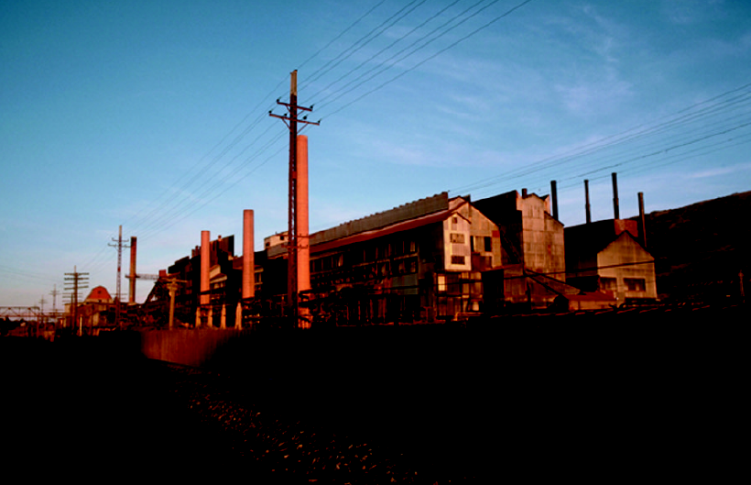
Fossil Fuel Contaminants
When fossil fuels are burned, they frequently have contaminants in them.
Sulfur contaminants in coal are a major source of air pollution.
  Sulfur combusts in air.
S_{8(g)} + 8 O_{2(g)} → 8 SO_{2(g)}
Next, a slow air oxidation of sulfur dioxide occurs.
2 SO_{2(g)} + O_{2(g)} → 2 SO_{3(g)}
Sulfur trioxide is a nonmetal oxide, i.e. an acid anhydride.
SO_{3(g)} + H₂O_{()} → H₂SO_{4(aq)}

Slide 61
Fossil Fuel Contaminants
Nitrogen from air can also be a source of significant air pollution.
This combustion reaction occurs in a car’s cylinders during combustion of gasoline.
N_{2(g)} + O_{2(g)} → 2 NO_{(g)}
After the engine exhaust is released, a slow oxidation of NO in air occurs.
2 NO_{(g)} + O_{2(g)} → 2 NO_{2(g)}

Slide 62
Fossil Fuel Contaminants
NO₂ is the haze that we call smog.
  Causes a brown haze in air.
NO₂ is also an acid anhydride.
  It reacts with water to form acid rain and, unfortunately, the NO is recycled to form more acid rain.
3 NO_{2(g)} + H₂O_{()} → 2 HNO_{3(aq)} + NO_{(g)}

Slide 63
Synthesis Question
When the elements Np and Pu were first discovered by McMillan and Seaborg, they were placed on the periodic chart just below La and Hf. However, after studying the chemistry of these new elements for a few years, Seaborg decided that they should be placed in a new row beneath the lanthanides. What justification could Seaborg have used to move these elements on the periodic chart?

Slide 64
Synthesis Question
Seaborg realized that the elements Np and Pu behaved chemically more like the lanthanides than they behaved like the transition metals. He applied the fundamental concept of periodicity. It has subsequently been proven that he was completely justified in his idea of moving these new elements on the periodic chart.

Slide 65
Group Question
What do the catalytic converters that are attached to all of our cars’ exhaust systems actually do? How do they decrease air pollution?

Slide 66
End of Chapter 6

